Slide 1

Intro to Maven
http://github.com/ostewart/maven-training

Slide 2
Agenda
Why Maven?
The Maven Way
Maven Basics
Multi-Module Projects
Web Projects
Integration Testing
Clean/Advanced Maven

Slide 3
What Is Maven?
Build tool (focused on JVM)
Convention over configuration
Structured project model
Build code reuse

Slide 4
Good Practices
Separate code, tests, resources
Platform independence
Declarative dependency management
Share resources via dependencies
Predictable directory structure
Test built artifacts

Slide 5
Maven Basics

Slide 6
Creating a New Project
<?xml version="1.0" encoding="UTF-8"?>
<project xmlns="http://maven.apache.org/POM/4.0.0"
xmlns:xsi="http://www.w3.org/2001/XMLSchema-instance"
xsi:schemaLocation="http://maven.apache.org/POM/4.0.0
http://maven.apache.org/xsd/maven-4.0.0.xsd">
<modelVersion>4.0.0</modelVersion>
<groupId>com.example.maventraining</groupId>
<artifactId>simple</artifactId>
<version>1.0-SNAPSHOT</version>
</project>

Slide 7
Running Maven
mvn <phase or goal> [<phase or goal>...]

Slide 8
Maven Lifecycles
Clean
Default
Site

Slide 9
Default Lifecycle (Abridged)
Validate
Compile
Test
Package
Integration-test
Verify
Install
Deploy

Slide 10

Dependency Management
<dependencies>
<dependency>
<groupId>junit</groupId>
<artifactId>junit</artifactId>
<version>4.11</version>
<scope>test</scope>
</dependency>
</dependencies>
Coordinates: groupId, artifactId, version, and optional scope

Slide 11
Dependency Scopes
compile (default)
provided
runtime
test
system
import

Slide 12
Snapshot Versions
Good for intra-project dependencies during development
Will check for updates each time you build
Will break your build eventually outside a single source tree
x.x-SNAPSHOT

Slide 13
Release versions
Generated by the release plugin
Assumed immutable (cached aggressively)

Slide 14
Directory Layout
src/main/java | Application/Library sources
src/main/resources | Application/Library resources
src/main/webapp | Web application sources
src/test/java | Test sources
src/test/resources | Test resources
target | Build output

Slide 15

Super POM
The POM from which all other POMs inherit
Look here for defaults
http://maven.apache.org/ref/3.0.4/maven-model-builder/super-pom.html
Image source: examiner.com

Slide 16
Exercise
Build a simple library that outputs "Hello, World!". Write a HelloWorld class that outputs a String and a test that invokes it. Build and test your project with Maven.

Slide 17
More Basics
Plugins
Packaging

Slide 18
Plugins
Maven's main unit of modularity
How most of Maven's functionality is implemented and configured

Slide 19
Plugin Configuration
<build>
<plugins>
<plugin>
<artifactId>maven-compiler-plugin</artifactId>
<version>3.1</version>
<configuration>
<source>1.6</source>
<target>1.6</target>
</configuration>
</plugin>
</plugins>
</build>

Slide 20
Built-In Plugins
maven-compiler-plugin
maven-surefire-plugin
maven-dependency-plugin
maven-release-plugin

Slide 21
Common Plugins
AntRun
Cargo
Jasmine
Exec
PMD
Cobertura
Findbugs

Slide 22
Packaging
Defines the artifact type
Binds goals to phases
Core values: pom, jar, maven-plugin, ejb, war, ear, rar, par
Default is jar

Slide 23
Packaging Binds Goals to Phases
Phase | Goal
process-resources | resources:resources
compile | compiler:compile
process-test-resources | resources:testResources
test-compile | compiler:testCompile
test | surefire:test
package | jar:jar
install | install:install
deploy | deploy:deploy

Slide 24
Exercise
Add isEmpty check on a String, set source/target compiler versions to 1.6

Slide 25
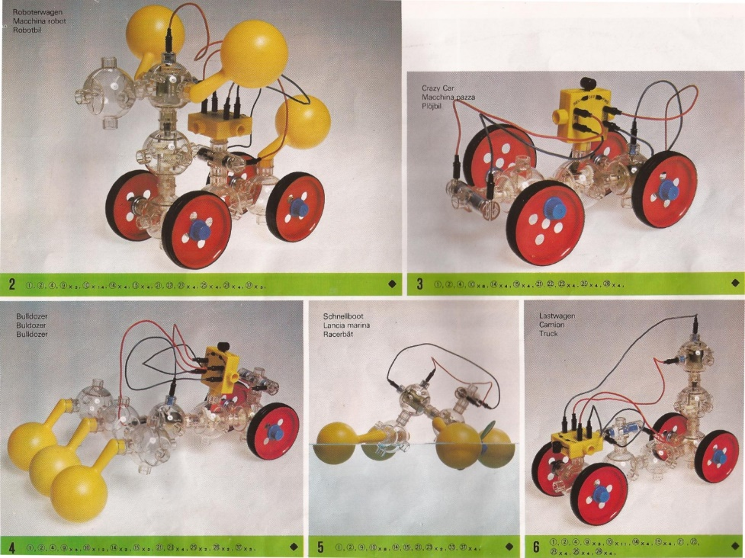
Multi-Module Maven
Why?
How?
Dependence vs. Inheritance
Naming

Slide 26
Why Multiple Modules?
Group related functionality
Isolate unrelated functionality
Organize dependencies
Unit for sharing code
Unit of packaging

Slide 27
Multi-Modules: How
Top-level pom packaging with modules
Optional parent in sub-modules

Slide 28
Modules
<modules>
<module>hello-util</module>
<module>hello-service</module>
</modules>

Slide 29
Parent
<parent>
<groupId>com.example.maventraining</groupId>
<artifactId>hello</artifactId>
<version>1.0-SNAPSHOT</version>
</parent>

Slide 30
Dependence vs. Inheritance
Use dependencies to share code, resources
Use inheritance to aggregate common settings

Slide 31
Naming
"There are only two hard things in Computer Science: naming, cache invalidation, and off-by-one errors." - almost Phil Karlton
All modules are top-level, referenced by groupId-artifactId
http://maven.apache.org/guides/mini/guide-naming-conventions.html

Slide 32
Exercise: Multi-Module
Now that we have a Hello utility, we'd like to use it to greet people on our roster of users. For each name on our roster, output "Hello, <name>!". While the Hello utility might be generally useful, this greeting service is specialized functionality, so it should go in its own module.

Slide 33
Bonus
Web modules
Integration testing with Cargo
Dependency management
Properties
Profiles

Slide 34
Web Modules
war packaging
Static resources in src/main/webapp
web.xml in src/main/webapp/WEB-INF

Slide 35
Exercise: Hello Web
We’d like to expose our HelloWorld utility as a web service. Write a simple servlet that extracts the name from the URL and serves the hello response as plain text.

